Slide 1

Using Arena to Study a Problem
Some Case Studies from Chapter 3

Slide 2
Case Study: Specialized Serial vs. Generalized Parallel Processing
Loan applications go through four steps
  Check credit
  Prepare covenant
  Price loan
  Disburse funds
Each step takes expo (1 hour)
  Meaning use an exponential distribution with a 1 hour mean for the delay
Applications arrive with expo (1.25 hour mean) interarrival times
First application arrives at time 0

Slide 3
  Run for 160 hours = 1 work month (40 hours a week for 4 weeks)
  Watch avg, max no. applications in process (WIP – work in process), avg, max total time in system of applications
  Four employees, each can do any process step
Question 1: Which is better - serial specialized processing or generalized parallel processing?
Question 2: What’s the effect of service-time variability on the answer to question 1?

Slide 4
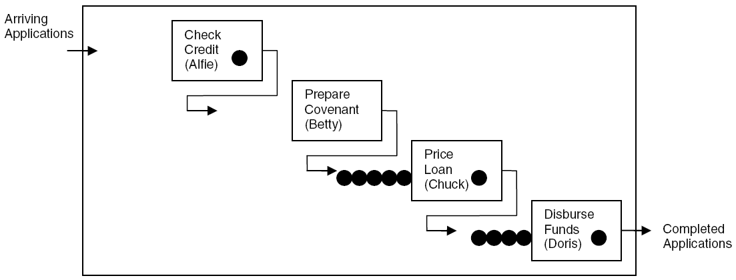
Case Study: Model 3-2,
Specialized Serial Processing
Betty’s idle but Chuck and Doris are overloaded – wasted capacity?
Investigate Model 03-02.doe

Slide 5
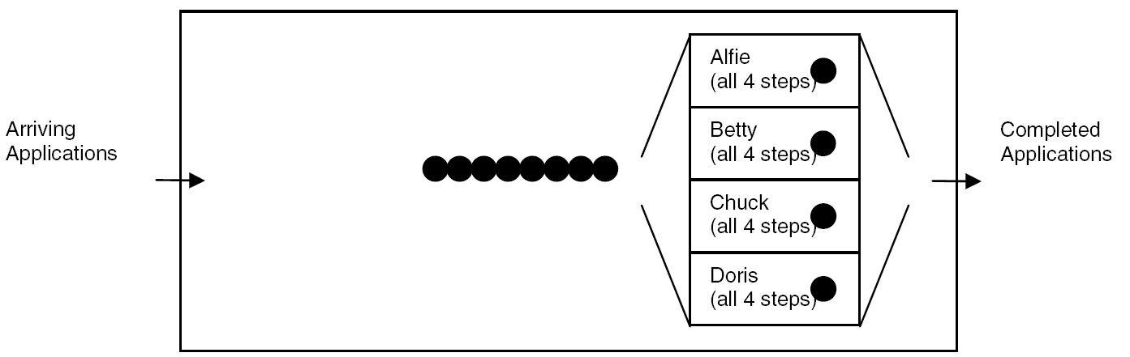
Case Study: Model 3-3,
Generalized Parallel Processing
Only one place to queue, but processing times are longer – sum of four IID expo (1 hour) times
Investigate Model 03-03.doe

Slide 6
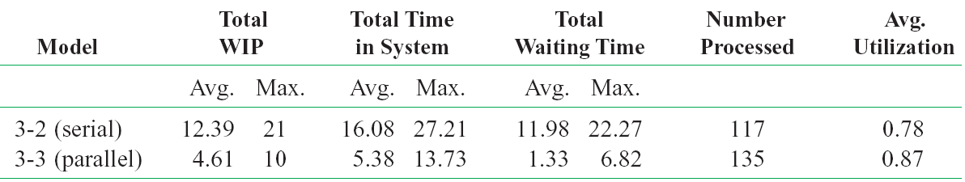
Case Study:
Compare Model 3-2 vs. 3-3
Caution: This is from only one replication of each configuration, so there’s output variability
  Are differences statistically significant? (Exercise 6-19)

Slide 7
Case Study:
Effect of Task-Time Variability
Is parallel always better than serial under any conditions?
  Many aspects could matter
  Focus on looking at only one: task-time variability
Now, each task time ~ expo (1 hour)
  This is a highly variable distribution
    Don't worry yet about how these calculations were made, but
    P(task time < 10 minutes) = 0.15
    P(task time > 2 hours) = 0.14
    This says about 15% of the tasks are very quick and about 14% take a very long time.
    Thus, there is a lot of variability in the time a task takes.

Slide 8
In the serial configuration, just one large task time congests greatly
In the parallel configuration it would also congest, but probably not by as much since the other three tasks are probably not all large too.
Other extreme – each task time is exactly 1 hour
Try simulating with this constant time for each task in order to see the effect the time variability is having on the study.
  Leave interarrival times as expo (1.25 hours)
  Models 3-4 (serial), 3-5 (parallel)
  Need to alter Process modules basically.

Slide 9
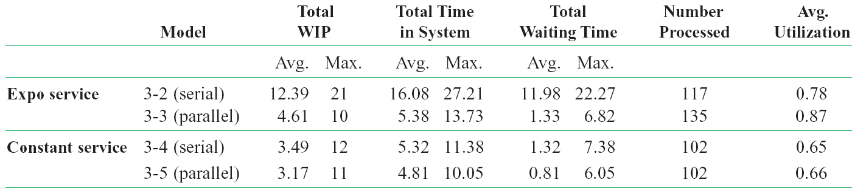
Case Study:
Effect of Task-Time Variability
For constant service, parallel improvement appears minor
  Maybe not even statistically significant (Exercise 6-19)

Slide 10
Some Further Possible Questions
In the parallel configuration, work is integrated/generalized, so would it be slower per task? (Exercises 3-13, 6-20)
What is the effect of worker breaks? (Chapters 4, 5)
Are the differences statistically significant or are they just spurious, the result of mere sampling fluctuation? (Exercises 6-19, 6-20)
What effect do multiple replications have on the results? How can you decide how many replications should be performed?

